Slide 1
College Admission Agent
IBM HACKATHON PROJECT
Presented By: Subha Pain
Faculty name : Piyush Pankaj
College Name & Department : RVSCET Electronics & Communication Engineering

Slide 2
OUTLINE
Problem Statement
Technology used
Wow factor
End users
Result
Conclusion
Git-hub Link
Future scope
IBM Certifications

Slide 3
Problem Statement
College admission staff spend a significant amount of time answering repetitive manual inquiries, which reduces overall efficiency.
Prospective students often find the college admission process complex, and information about policies, eligibility, and FAQs is scattered across various sources.
Applicants require instant and accurate answers to their questions about course selection, fees, and important deadlines, but often face delays.
College admission staff spend a significant amount of time answering repetitive manual inquiries, which reduces overall efficiency.
There is a need for an intelligent system that can streamline the admission process, making it more transparent and accessible for applicants 24/7.

Slide 4
Technology used
IBM cloud lite services
Natural Language Processing (NLP)
Retrieval Augmented Generation (RAG)
IBM Granite model

Slide 5
IBM cloud services used
IBM Cloud Watsonx AI Studio
IBM Cloud Watsonx AI runtime
IBM Cloud Agent Lab
IBM Granite foundation model

Slide 6
Wow factors
24/7 Availability: Students can get answers anytime, day or night, without waiting for office hours.
Instant and Accurate Answers: Provides immediate and correct information from the official documents, eliminating waiting times and human errors.
Handles Complex Queries: The agent is smart enough to answer complex questions that combine multiple details, like asking for the total fee including hostel costs and the final application deadline in a single sentence.
Reduces Staff Workload: Automatically handles thousands of repetitive questions, freeing up the admission staff to focus on more critical tasks.
Personalized Experience: Gives every student a one-on-one interaction, making the admission process feel more accessible and less stressful.

Slide 7
End users
Prospective Students: The primary users of the agent, such as 12th-grade students and other applicants who want to apply for admission.
Parents and Guardians: Family members who are involved in the admission process and need information about fees, hostel facilities, and deadlines.
College Admission Staff: The admission office employees who benefit from the automation of repetitive questions, allowing them to focus on more complex issues.
High School Counselors: Career advisors who can use the agent to get instant and accurate information about the college's programs to guide their students effectively.

Slide 8
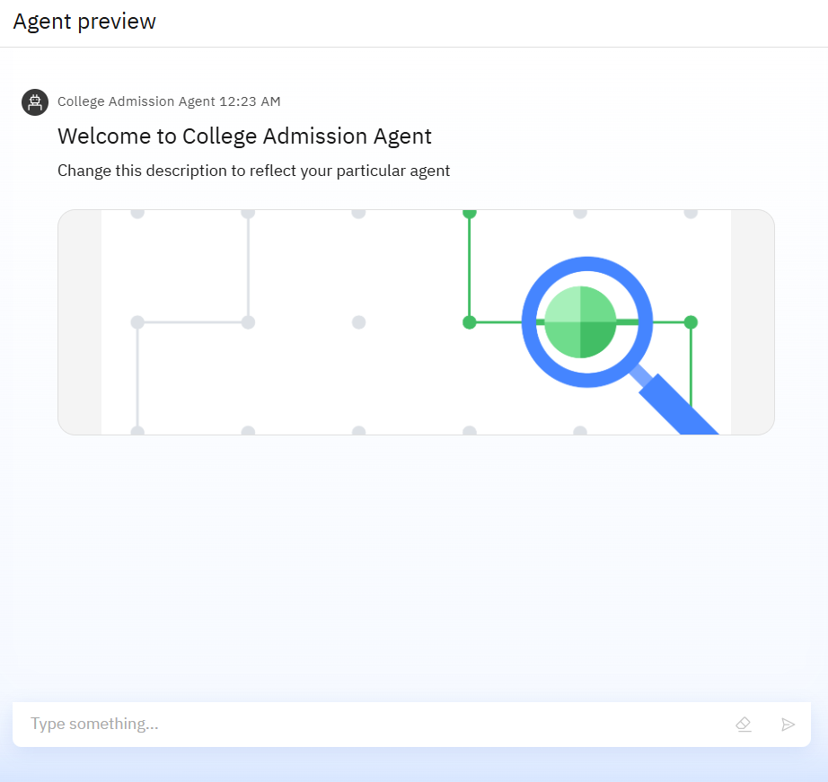
Results

Slide 9
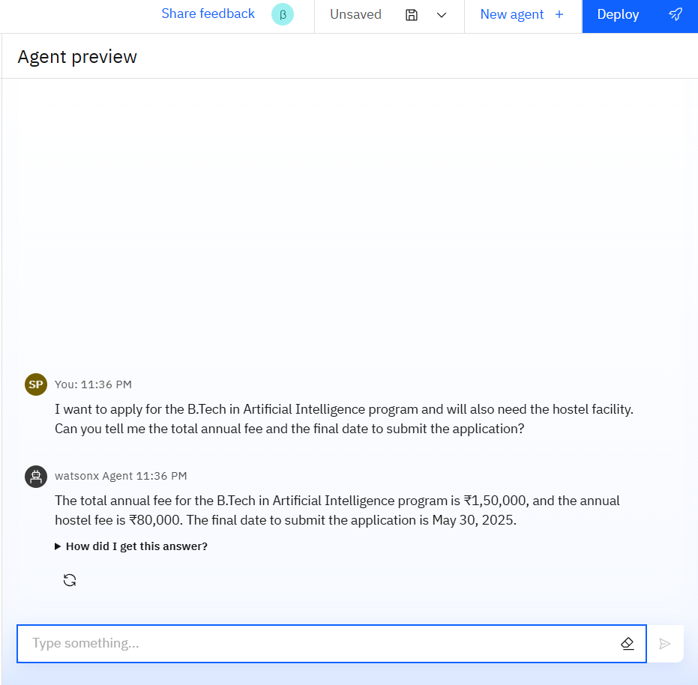
Results

Slide 10
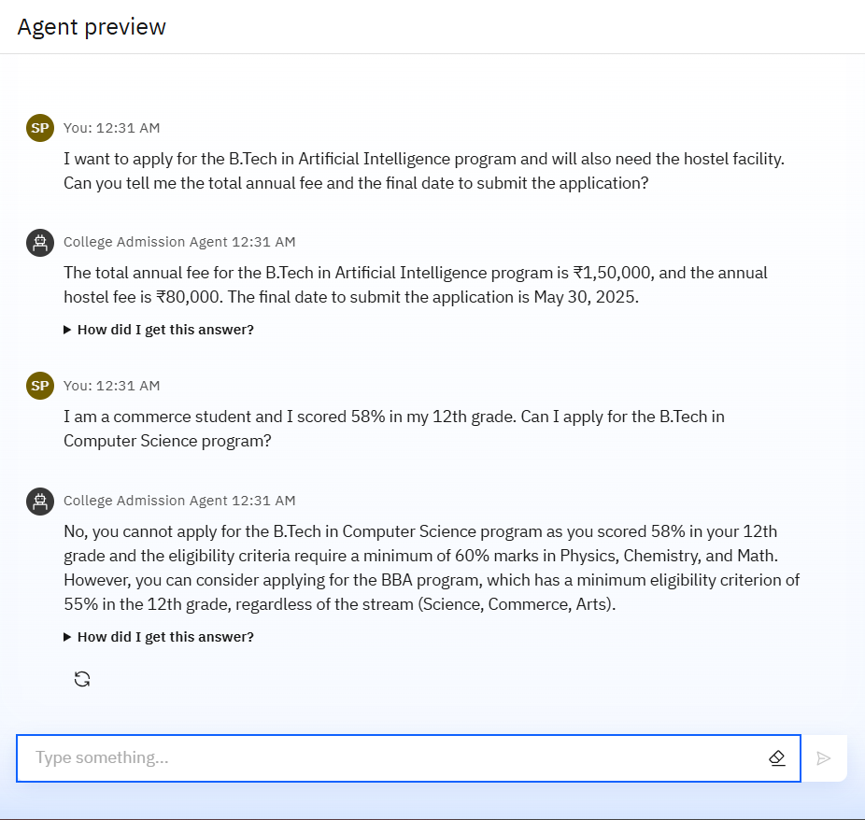
Results

Slide 11
Conclusion
We successfully developed an intelligent College Admission Agent using IBM Watsonx.ai, which directly addresses the challenges of the traditional admissions process.
By using Retrieval-Augmented Generation (RAG), the agent provides prospective students with instant, accurate, and reliable answers to their queries 24/7.
The solution significantly enhances the applicant experience and boosts the efficiency of the admissions staff by automating repetitive tasks.
This project demonstrates that AI-powered assistants are a powerful tool for educational institutions, making critical information more transparent and accessible for everyone involved.

Slide 12
GitHub Link
You can find the complete project details, data file, and documentation at the following GitHub repository.
https://github.com/SUBHAPAIN/College-Admission-Agent
What you will find in the repository:
A detailed README.md file explaining the project.
The data file used to train the agent.
Screenshots and the final presentation.

Slide 13
Future scope
Multilingual Support: To train the agent to support multiple regional languages (such as Hindi), making it accessible to a more diverse student population.
Voice Integration: To add a voice feature that allows students to ask questions by speaking, making the agent even more user-friendly.
Live Application Tracking: To connect the agent to the college's live admissions database, enabling students to check the real-time status of their application (e.g., 'Submitted', 'Under Review', 'Approved’).
Proactive Reminders: To enable the agent to automatically send proactive reminders to applicants regarding important deadlines or missing documents.
Direct Application Submission: To provide a feature that allows students to fill out and submit their admission forms directly through the chat interface.

Slide 14
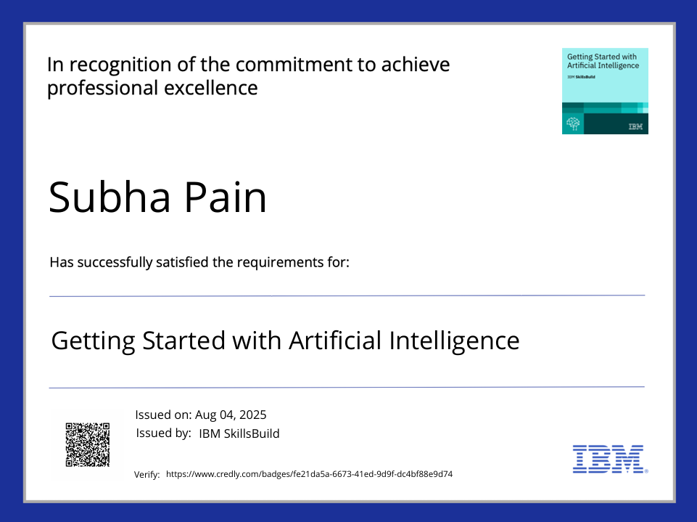
IBM Certifications

Slide 15
THANK YOU

